Slide 1
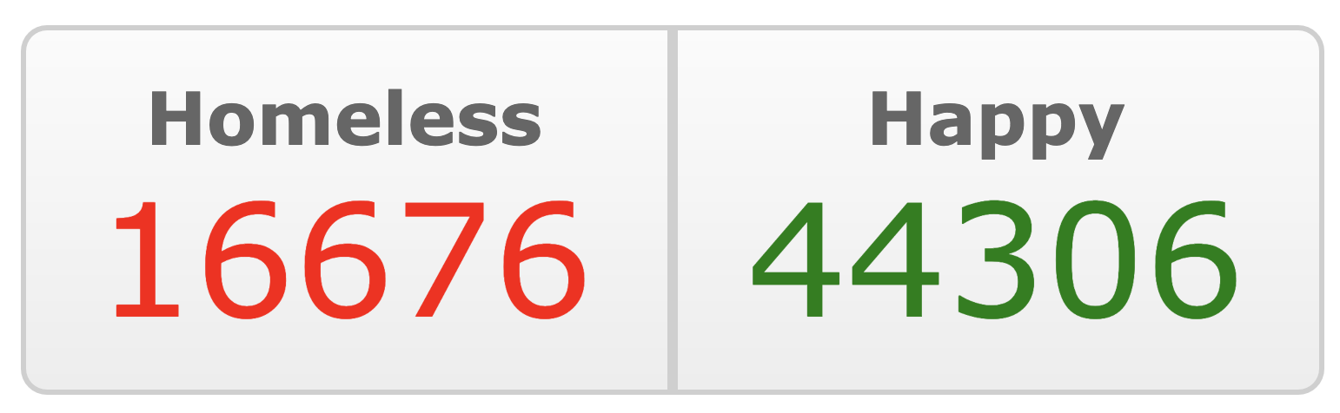
Predicting Pet Adoptions
Capstone 2: Supervised Learning
Emily Manne-Nicholas

Slide 2
Petfinder.my: A Quick Overview
Online searchable database of over 150,000 pets who need homes in Malaysia, founded in 2008
3 Missions:
Facilitate communication between rescuers, fosters, and adopters
Unify adoptions into single online system
Educate public on pet care via forums

Slide 3

Motivation
Help rescues understand what drives adoption times
optimize advertising strategy of pets to minimize adoption times
plan better for resource needs
Help adopters understand what pets are most in need of adoption
Notes:
Pc https://i.redd.it/bbzgyt2i0s431.jpg

Slide 4
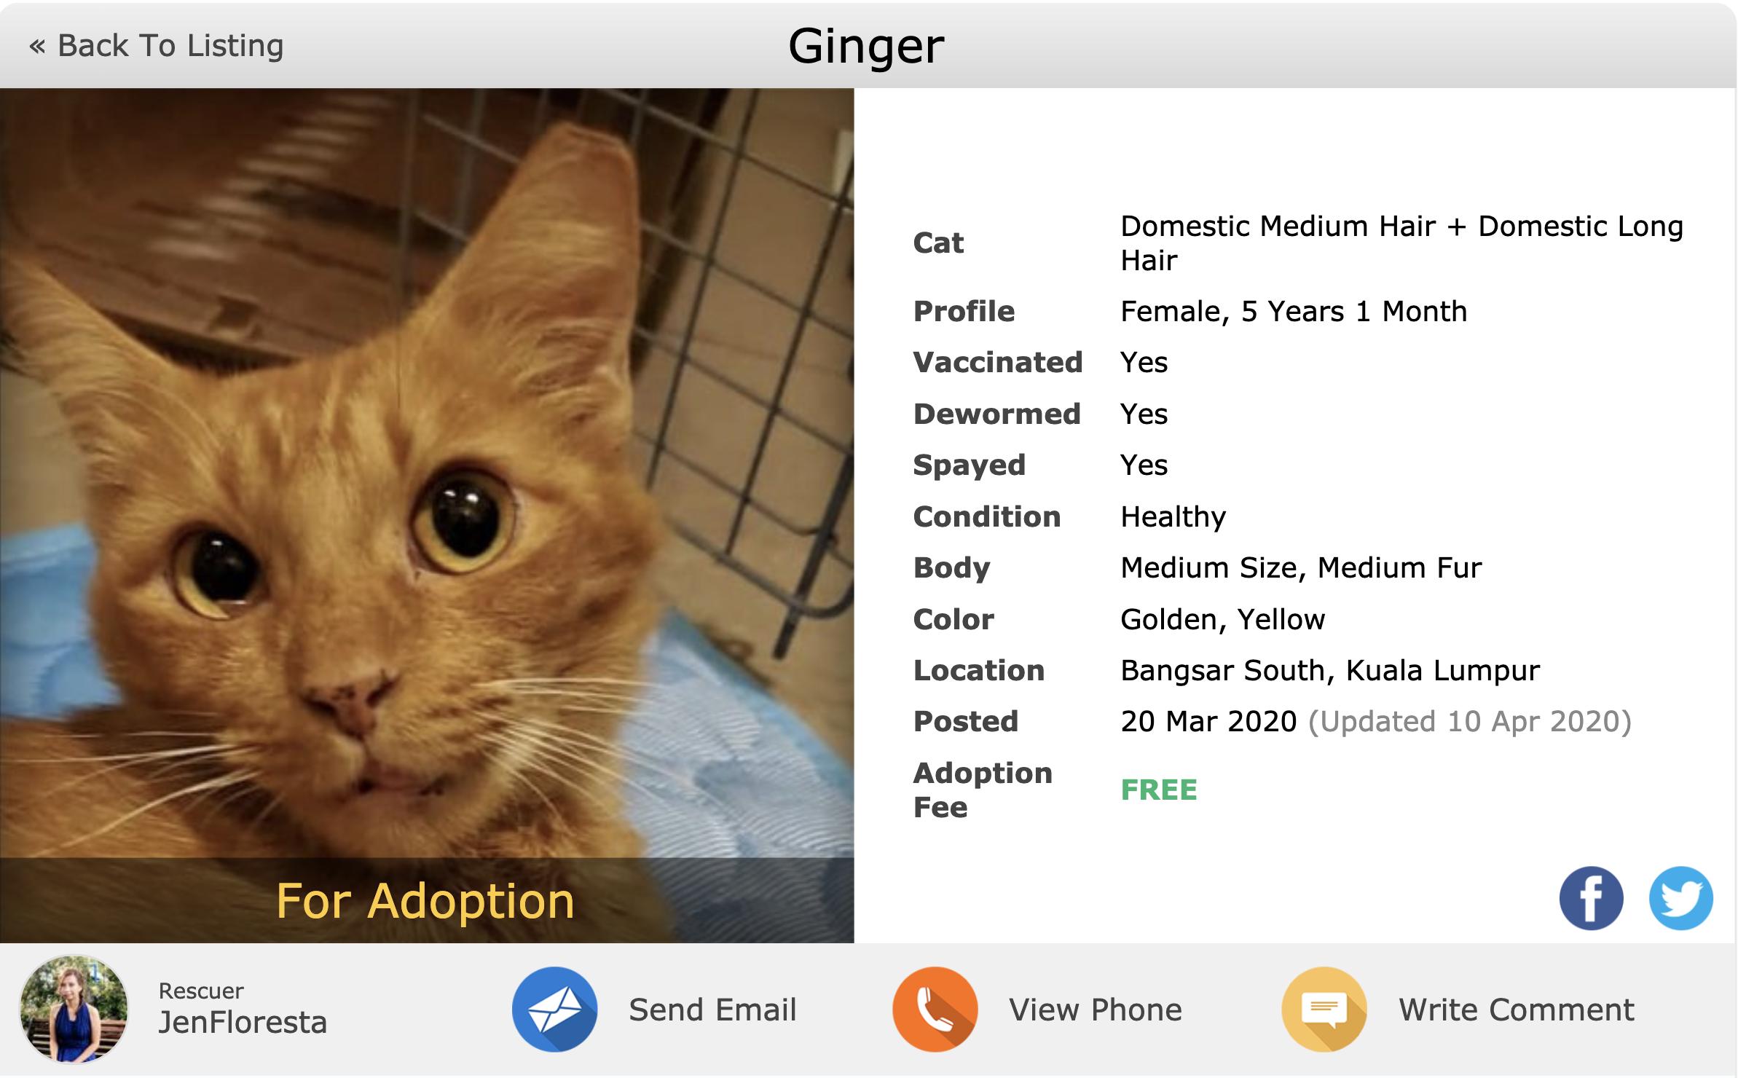
Notes:
Typical listing

Slide 5
The Dataset
~15,000 cats/dogs
Name, rescue, location, breed, color, size, gender, age, fur length, fee, health status, photo/video amt, etc…

Slide 6
Goal: To Predict Adoption Speed
Adoption Time:
0 – Same day
1 – 1st week (1 – 7 days)
2 – 1st month (8 – 30 days)
3 – 2nd & 3rd month (30 – 90 days)
4 – No adoption after 100 days
Notes:
Pc. https://www.lamag.com/culturefiles/5-inspiring-places-l-adopt-dog/

Slide 7
The Model
Random forest classification with gradient boosting
Predicts correct adoption times ~38% of the time
19% better than randomly guessing
Why so poor predictive power?
Not enough same-day adoption data (410/14993)
Missing features?
Photo and description data
Adoption time tough to predict!
So what can we glean?

Slide 8
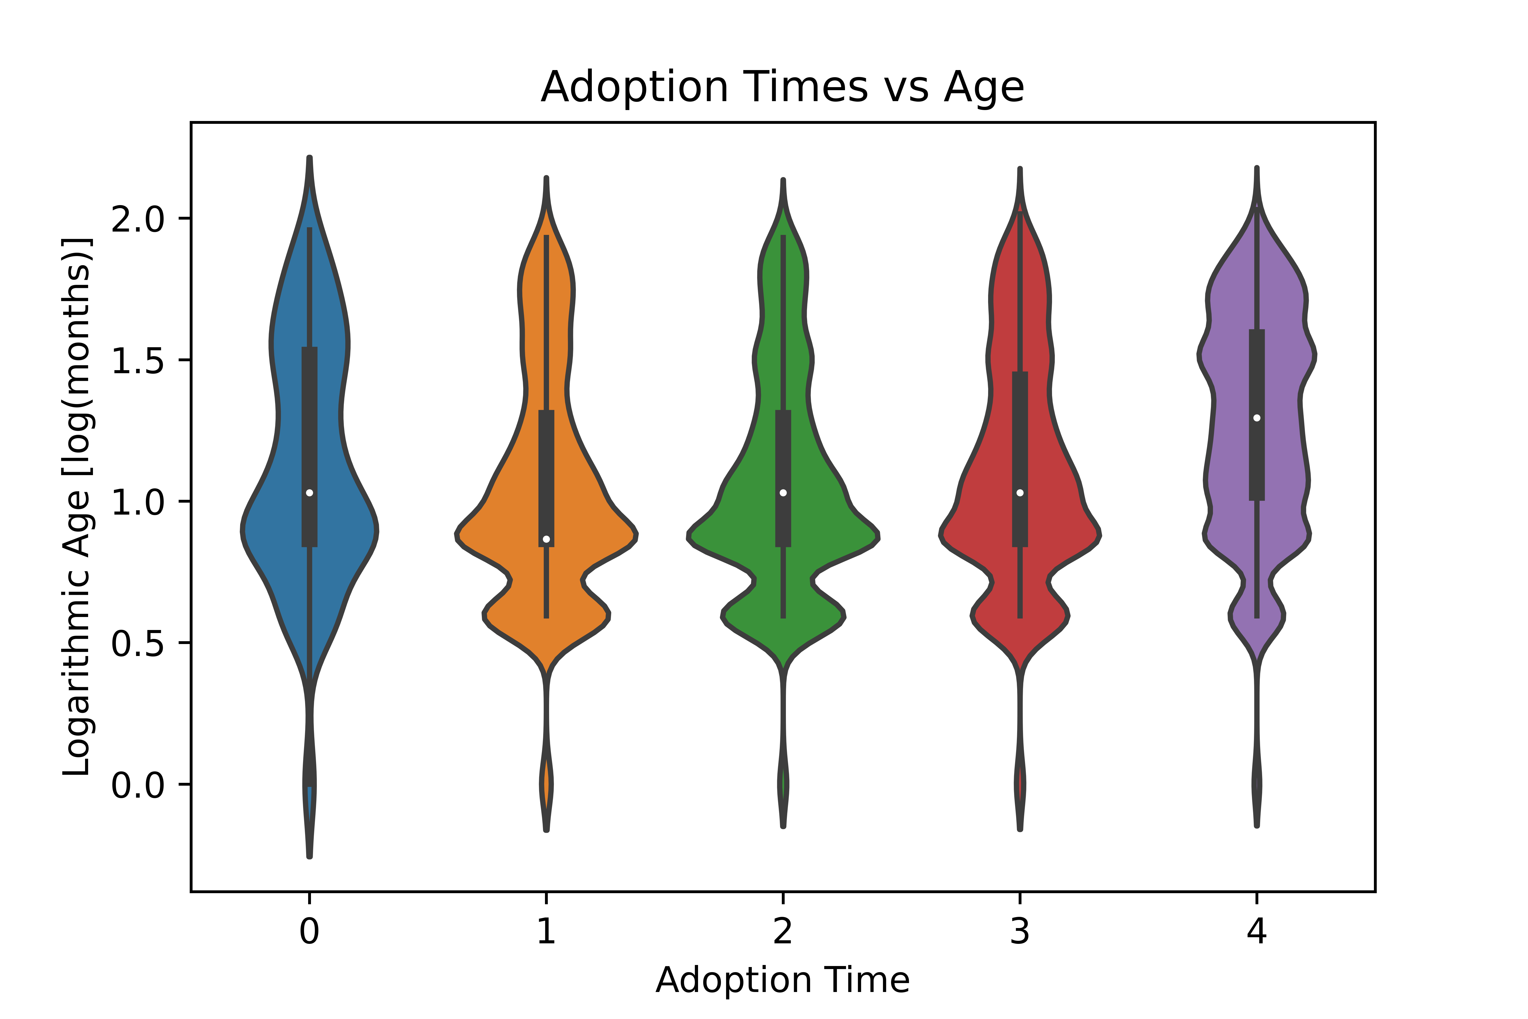

Slide 9
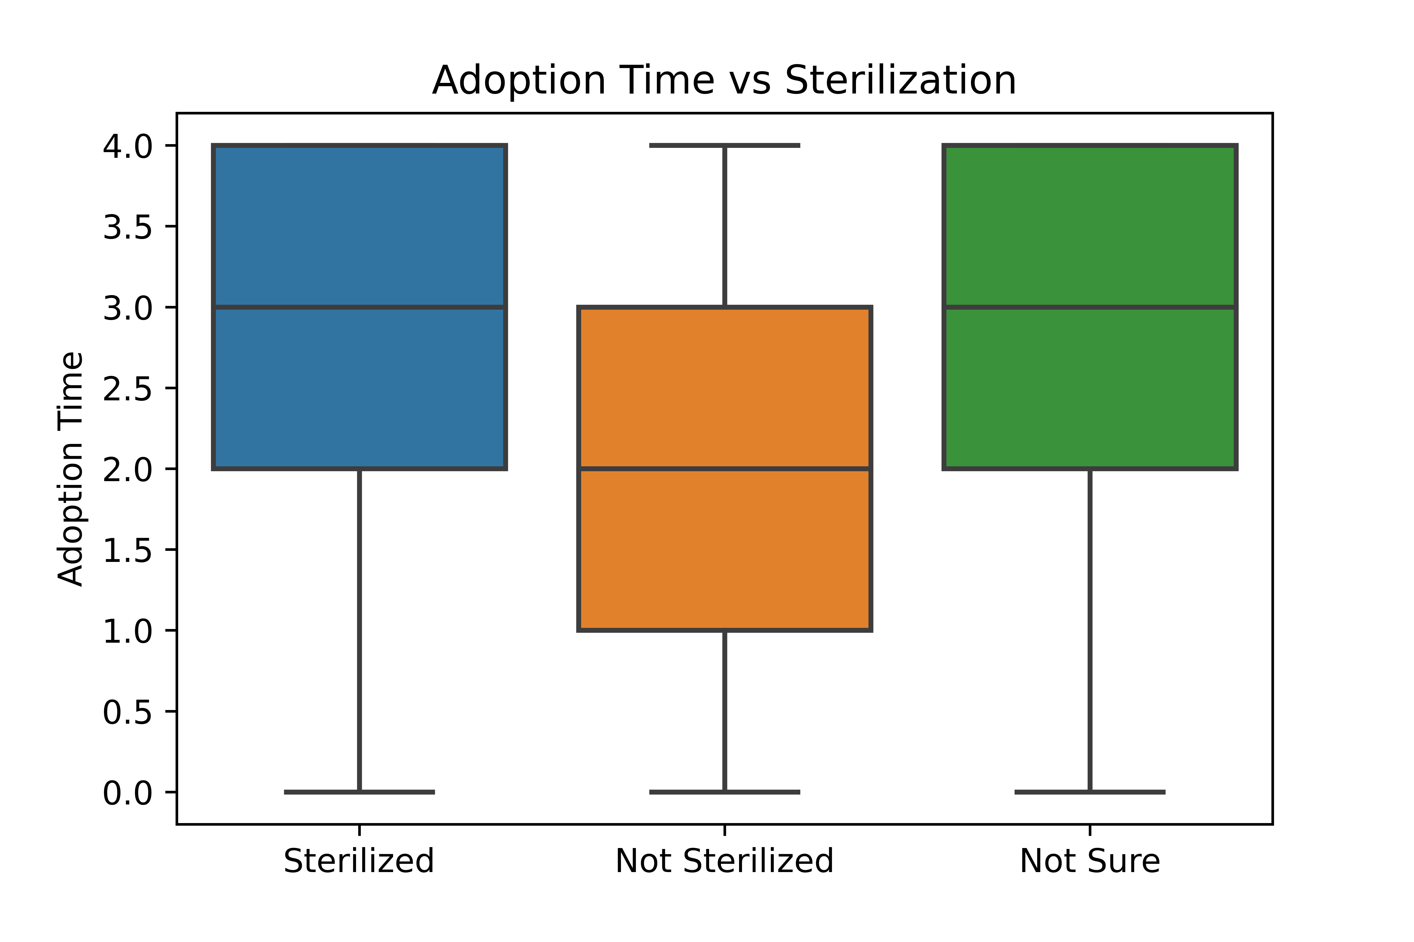
Notes:
Sterilization may increase cost, may be less preferred in Malaysia, may be correlated with age…

Slide 10
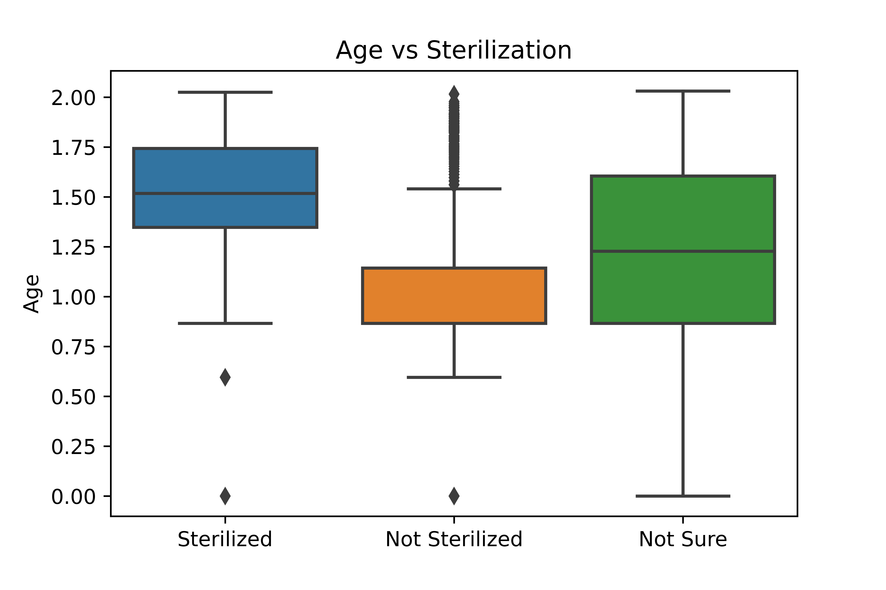
Notes:
We see similar patterns for deworming and vaccination statuses.

Slide 11
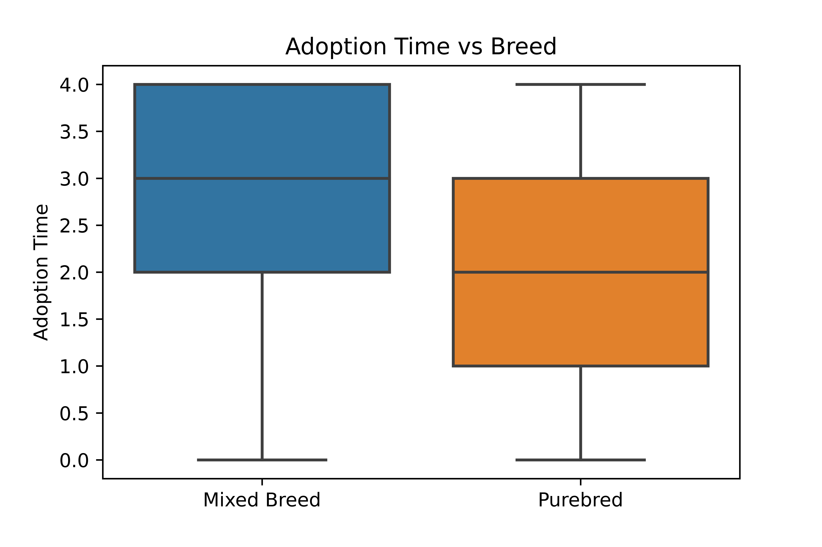

Slide 12
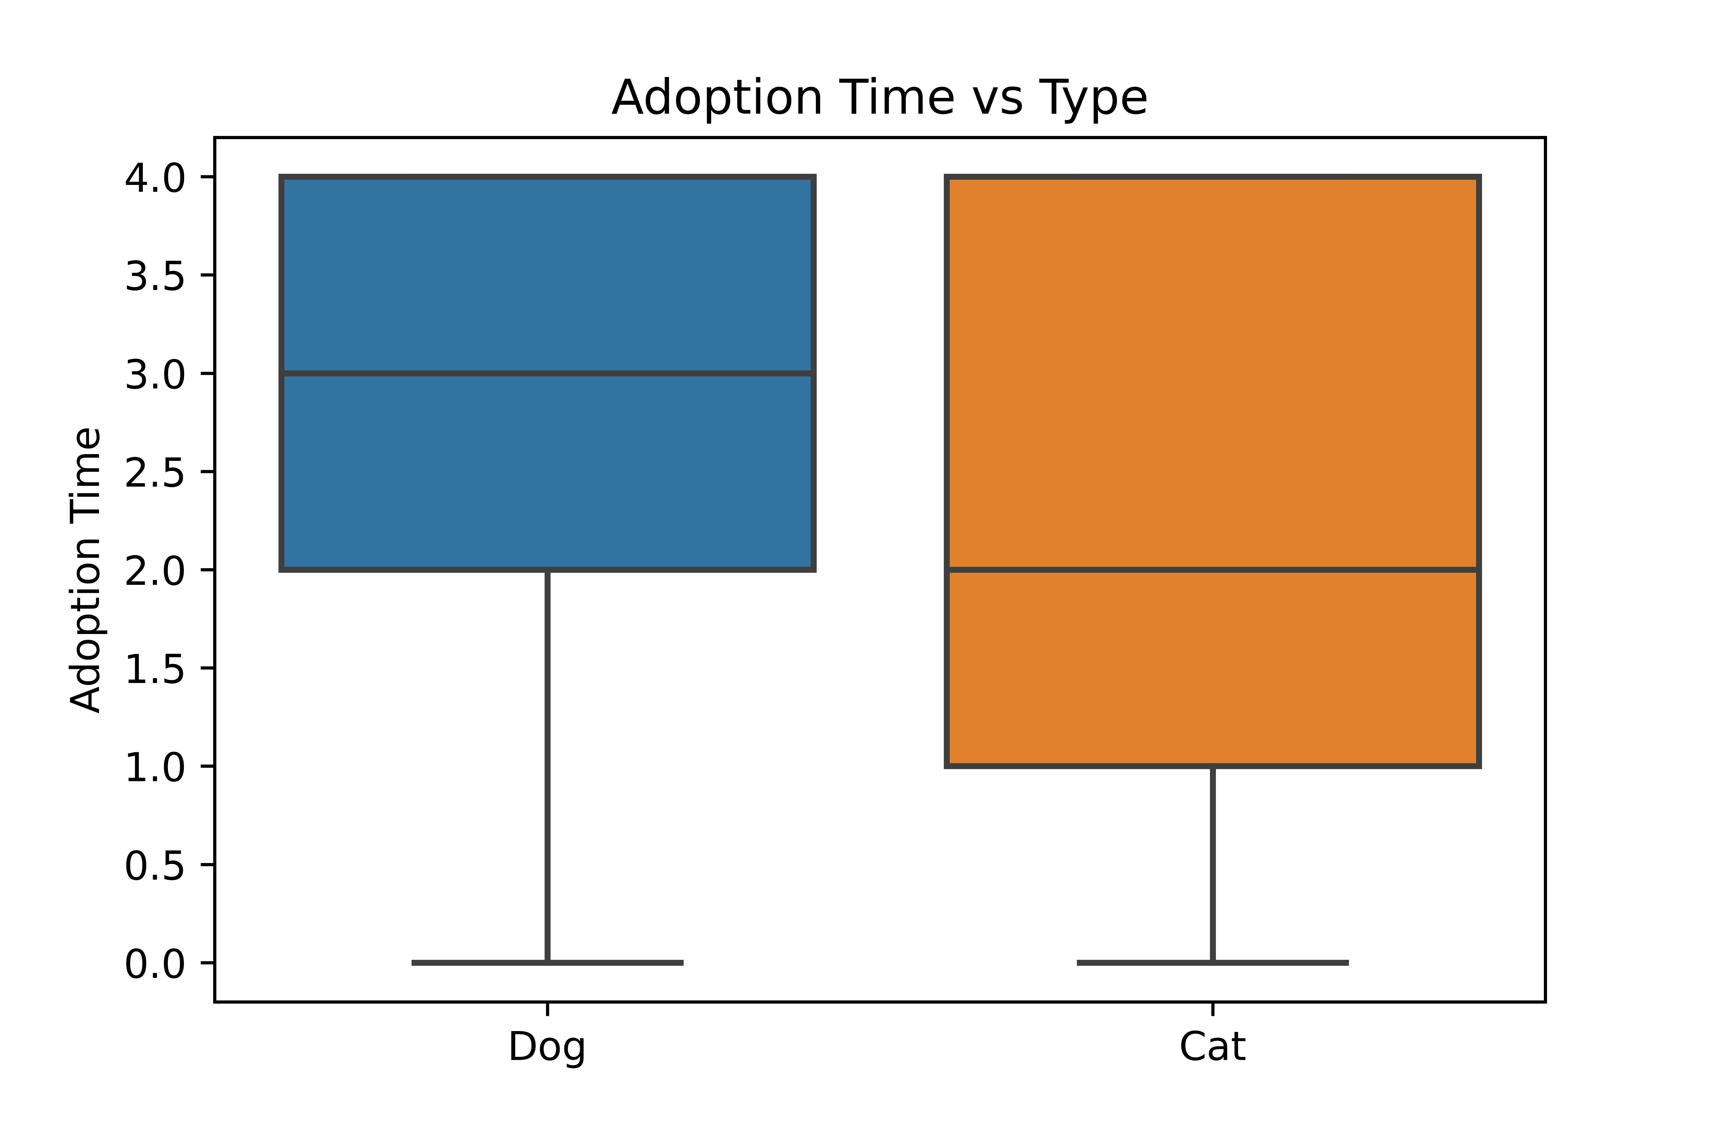

Slide 13
Key Takeaways
Younger (unaltered), purebred, animals seem to get adopted more quickly
Cats likely adopted more quickly than dogs
Shelters taking on mixed breed older dogs need to plan for longer stays and work harder to advertise/incentivize those adoptions
People looking to make an impact on animal welfare may want to consider adopting from needier demographics

Slide 14
Future Work
Tease out interactions between age and other features:
sterilization, deworming, vaccination
Investigate impact of adding features derived from photo and description info
Compare to Petfinder (North America)
Create AI tool that evaluates a post and returns:
Recommendations about how to optimize profile
Estimated time until adoption
Recommended adoption fee
Neediness index

Slide 15

Questions?

